Slide 1
K. Hilmi Vice Chair IOC/UNESCO Group V & MONGOSS Co Chair
SHAREMED International Workshop – 13 & 14th September 2022 - Malta

Slide 2
Reminder
In 2016, the Intergovernmental Oceanographic Commission of UNESCO (IOC) initiated a concept for such a campaign.
In December 2017, this work culminated in the proclamation by the 72nd Session of the UN General Assembly (UNGA) of the UN Decade of Ocean Science for Sustainable Development 2021-2030 (referred to as ‘the Ocean Decade’).
UNGA called on the IOC to prepare an Implementation Plan for the Ocean Decade in consultation with Member States, United Nations partners and diverse stakeholder groups.

Slide 3
The process so far (1)
Global Planning Meeting in May 2019 with > 200 participants
11 regional planning workshops with > 1900 attendees
ECOP Informal Working Group created
Three meetings of UN-Oceans contact group
Ocean Literacy & UN agencies Data Management thematic meetings
Ongoing engagement of Executive Planning Group
Virtual sessions presenting zero draft of Implementation Plan to > 600 people
Peer review of zero draft of Implementation Plan => 228 written submissions including 42 from IOC/UNESCO Member States
IOC / UNESCO Member State and UN agency review of Version 1.0 of Implementation Plan => 44 written submissions from Member States & 7 from UN agencies
This process resulted in Version 2.0 of the draft Implementation Plan

Slide 4
The process so far (2)
September to December 2020: Negotiation of Omnibus Resolution including Implementation Plan
15 October 2020: Information Session to present Implementation Plan to UN Member States
15 October 2020: Launch of first “Call for Decade Actions” for programmes and major contributions
4 December 2020: Virtual high-level supporters event and pre-launch of Ocean Decade Alliance
1 January 2021: Decade starts
January – October 2021: Progressive establishment of coordination structures and roll-out of Stakeholder Engagement Mechanisms
March – April 2021: Decisions on first group of endorsed Decade Actions (programmes and contributions)
31 May – 2 June 2021: First International Ocean Decade Conference, Berlin
2021-2022: CoDesign Conferences, UN Ocean Conference (Lisbon), IOCAfrica Ocean Decade Conference (Egypt - Roadmap for Africa), Mediterranean Projects, etc;....

Slide 5
Decade Vision & Mission
“
Vision
The science we need for the ocean we want
***
Mission
Transformative ocean science solutions for sustainable development, connecting people and our ocean.

Slide 6
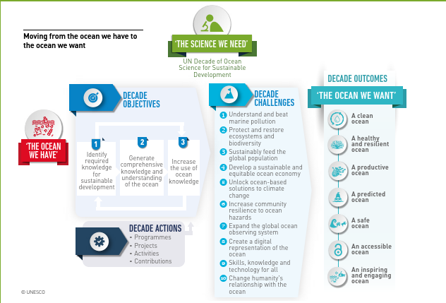
Objectives and Actions of the Ocean Decade

Slide 7
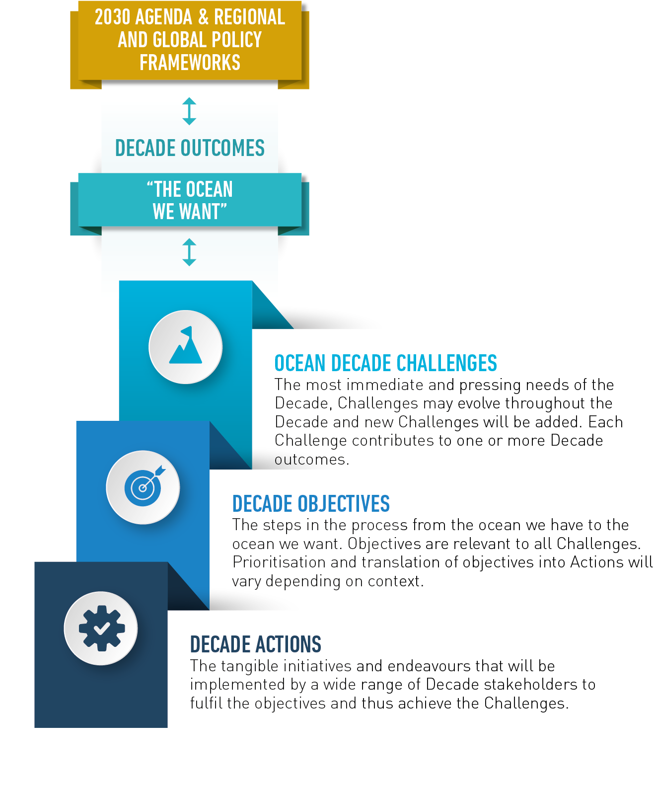
Decade Action Framework

Slide 8
Address land and sea-based sources of pollutants and contaminants.
Protect, monitor, manage and restore ecosystems under multiple stressors
Optimise the role of the ocean to sustainably feed the world’s population.
Contribute to equitable and sustainable development of the ocean economy.
Understand the ocean-climate nexus, build resilience and improve predictions and forecasts.
Expand multi-hazard warning systems and mainstream community preparedness and resilience.
Ensure a sustainable ocean observing system that delivers timely data and across all ocean basins.
Develop a comprehensive digital representation of the ocean.
Ensure comprehensive capacity development and equitable access to data, information, knowledge and technology.
Identify and overcome barriers to the behaviour change that is required for a step change in humanity’s relationship with the ocean.
Ocean Decade Challenges
“
Challenges will evolve over the life of the Decade.

Slide 9
Decade Outcomes
Describe the ‘ocean we want’ at the end of the Decade.
A clean ocean where sources of pollution are identified, reduced or removed.
A healthy and resilient ocean where marine ecosystems are understood and managed.
A productive ocean supporting sustainable food supply and a sustainable ocean economy.
A predicted ocean where society understands and can respond to changing ocean conditions.
A safe ocean where life and livelihoods are protected from ocean-related hazards.
An accessible ocean with open and equitable access to data, information, and technology and innovation.
An inspiring and engaging ocean where society understands and values the ocean in relation to human wellbeing and sustainable development.

Slide 10
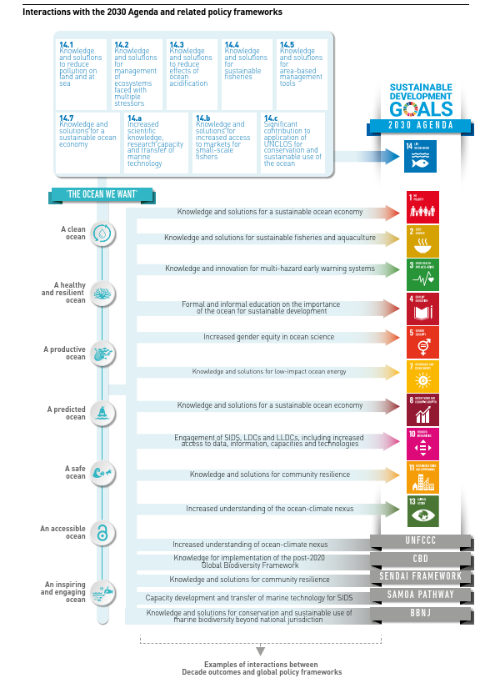
Decade Outcomes

Slide 11
Decade Actions include programmes and projects, as
well as activities and/or contributions:
• A Decade programme is typically global or regional
in scale and will contribute to the achievement of
one or more of the Ocean Decade Challenges. It is
long-term, multi-year, interdisciplinary and multi-
national. A programme will consist of component
projects and potentially enabling activities.
• A Decade project is a discrete and focused
undertaking. It may be regional, national or sub-
national and it will typically contribute to an identified
Decade programme.
Decade Actions
• A Decade activity is a one-off, standalone initiative
(such as an awareness-raising event, scientific
workshop or thematic training opportunity).
It enables a programme or project or directly
contributes to an Ocean Decade Challenge.
• A Decade contribution supports the Ocean Decade
through provision of resources (e.g. funding or an
in-kind contribution). A contribution can support
either the implementation of a Decade Action or the
coordination functions of the Ocean Decade.

Slide 12
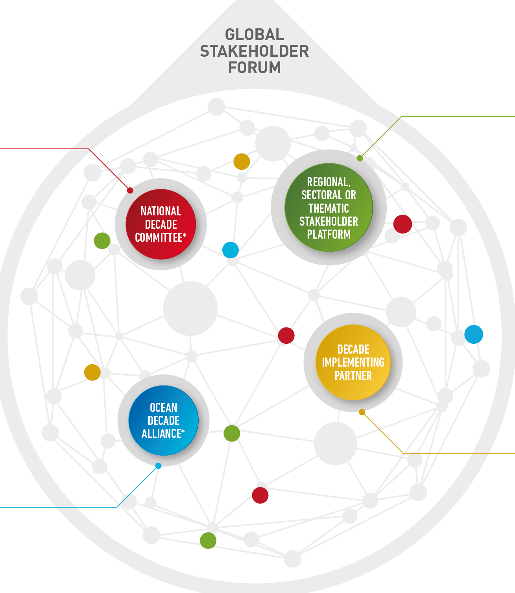
Stakeholder Engagement
Global Stakeholder Forum: actively managed communities of practice that will collaborate online and in-person.

Slide 13
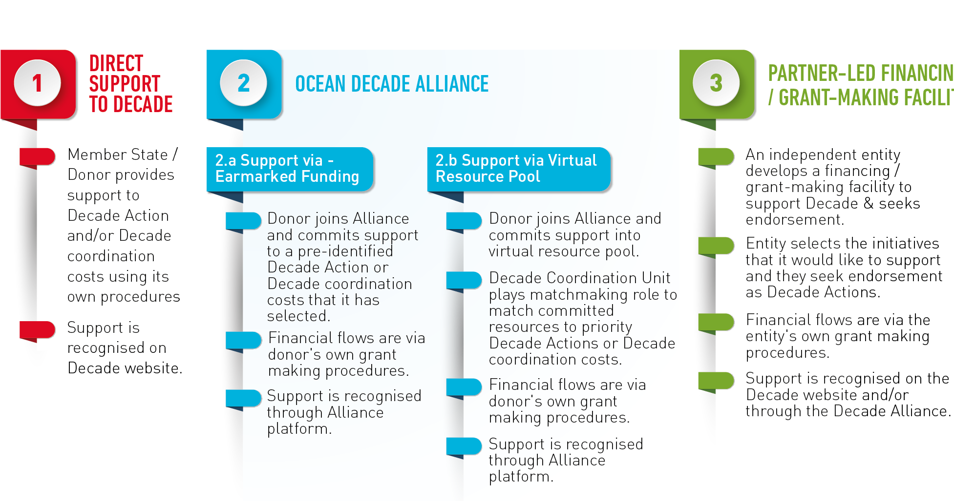
Resource Mobilisation
“
The Decade is not a funding mechanism. It encourages alignment of resource mobilisation strategies with Decade priorities.

Slide 14
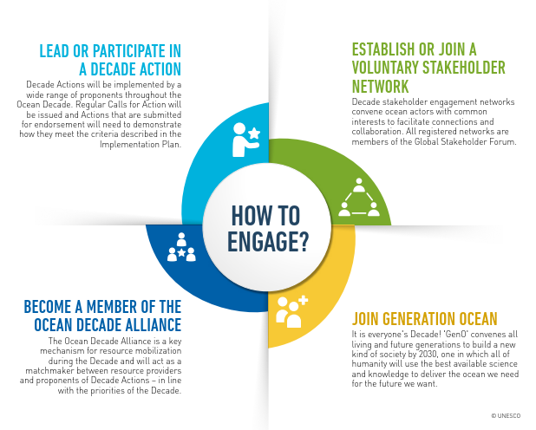
How to Engage?

Slide 15
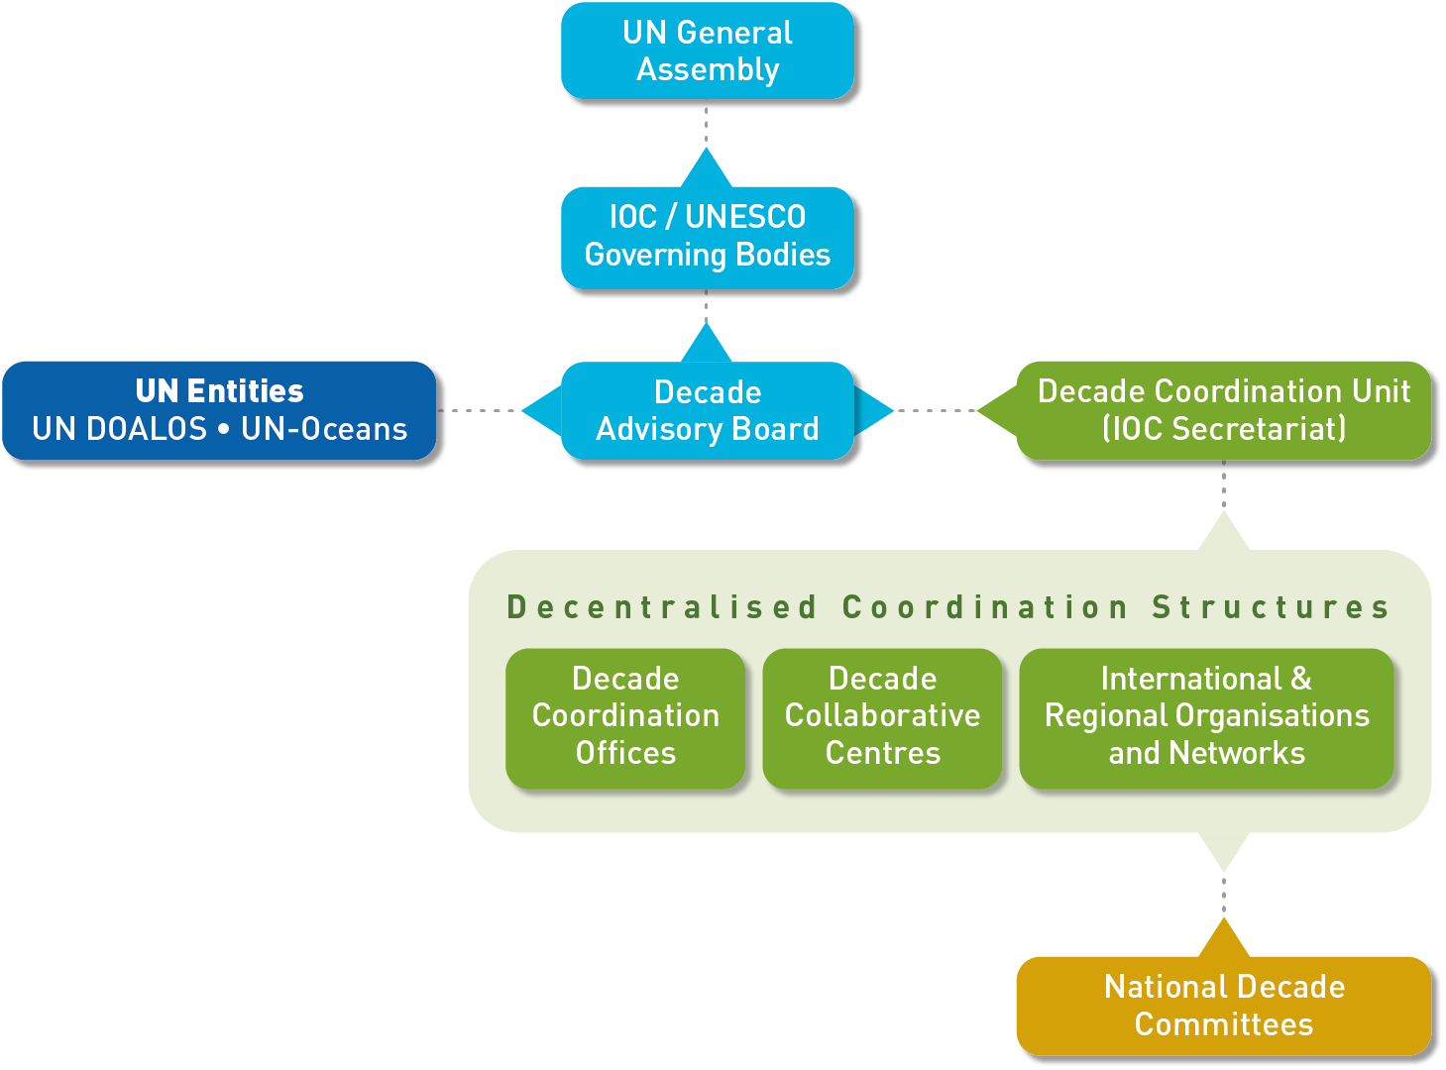
Coordination of the Decade
“
Simple, agile approach that builds on existing structures and processes

Slide 16
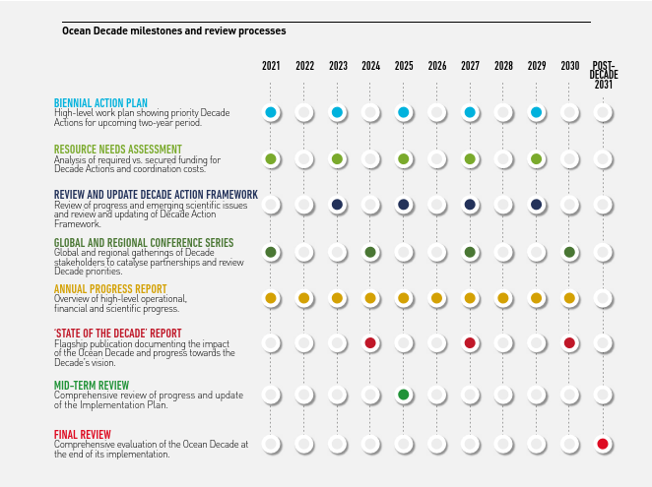
How to follow the Decade?

Slide 22
The process so far (1)
Thank you for your attention

